Slide 1
Ben Reynolds & James Pyke
Level 6 Group 7
GAMES PROJECT
Notes:
1
Ben: Hello, we're Group 7, I am Ben Reynolds, and this is James Pyke. And we're here today to present to you our idea for this year's Games Project module.

Slide 2
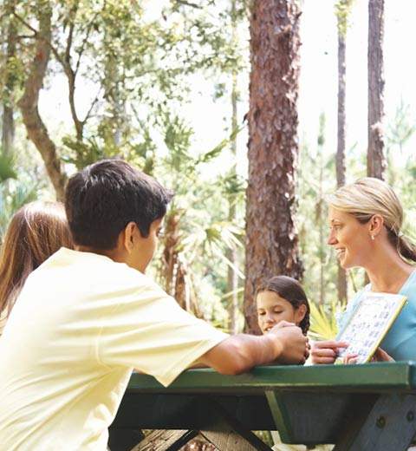


INTRODUCTION
Brief
To create an educational game to be used on school trips at Go Ape. The game should include both a progression mechanic and an educational element touching on some of the KS1, KS2 or KS3 topics of English, Science or Maths.
The created game must:
Follow the Go Ape brand guidelines.
Be suitable for a single age range, 5–7, 8–10 or 11-14.
Be accessible on mobile phones or tablets.
Notes:
2
James:​ During the summer break, we reached out to Go Ape, the outdoor adventure company and asked if they would be interested in collaborating with us for this year's Games Project module. After some discussions with their marketing team, they provided us with the brief that you can see on screen now. The brief describes an educational game that children would play while visiting Go Ape on school trips and that would aid them in developing either their Key Stage 1, 2 or 3 skills in English, Math and Science.

Slide 3
KEY STAGES
 | KS1 | KS2 | KS3
English | Applying phonic knowledge, reading multi-syllable words. | Knowledge of root words, prefixes and suffixes | Knowing the purpose, audience for and context of the writing and drawing on this knowledge to support comprehension.
Maths | 5 × 12 = ?? 80 ÷ 10 = ?? | 500 + (36 ÷ 3) = ?? 30 × 40 = ?? | Simplify (5-x)+4(x2+1) 4.15 + 6.2 = ??
Science | Identify common plants, animals and every day materials | Recording findings using simple scientific language, labelled diagrams, keys, bar charts, and tables. | Understand forces, energy, reactions, organisms, review theories and test hypotheses.
https://www.gov.uk/education/school-curriculum
Notes:
3
Ben: To understand the degree of study involved in each of the aforementioned key stages, we examined the national curriculum available on the government services and information website. The table you can see on screen summarises these findings and has helped us in determining the age range and key learning stage that the game will target.

Slide 4
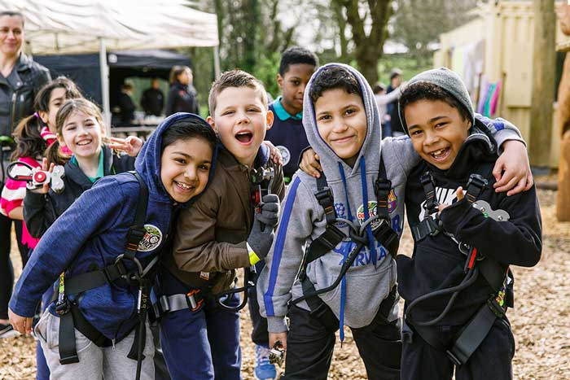
WHO’S IT FOR?
Target Audience
5 – 7 Year Olds
Genre
Educational, Logic, Trivia
Notes:
4
James: We have chosen to develop an educational trivia and logic game targeted towards primary school children between the ages of five and seven that are learning the key stage one curriculum.

Slide 5
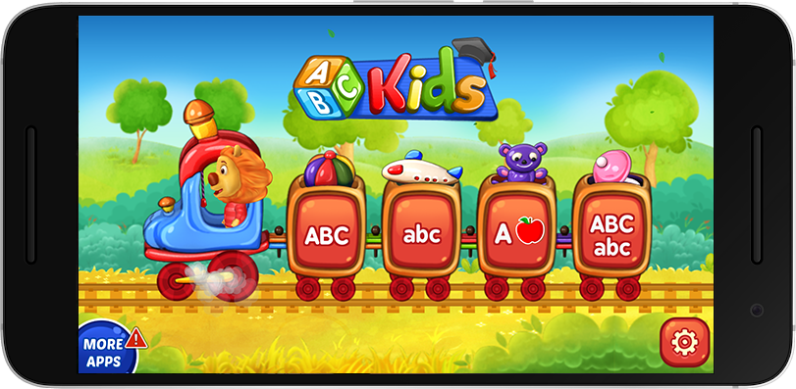
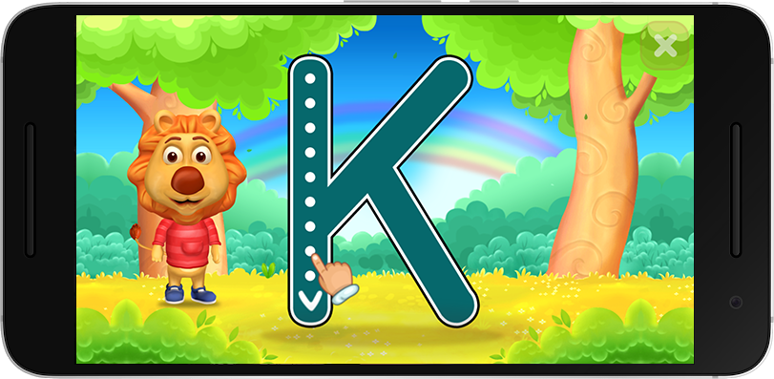
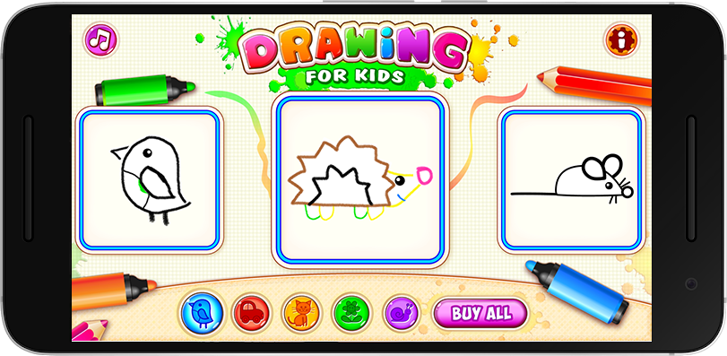
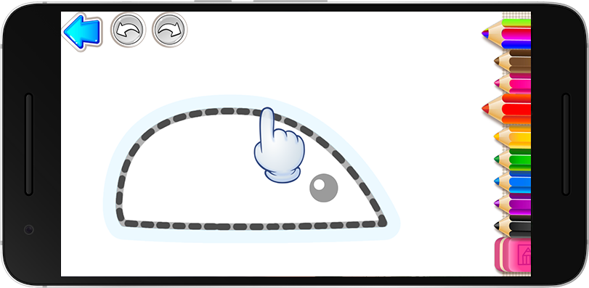
OTHER GAMES
Notes:
5
Ben: After deciding on our demographic, we spent some time analysing existing games targeted towards a similar audience. A few of which you can see on screen now. The better of the games that we played were engaging in that they contained straight-forward goals, frequent rewards, upbeat music and a lot of visual and audial feedback to player actions.

Slide 6
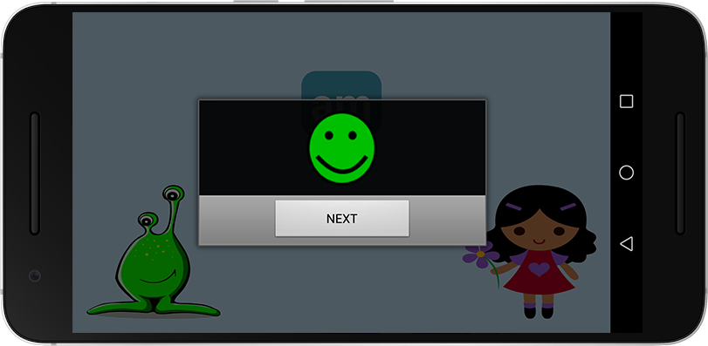
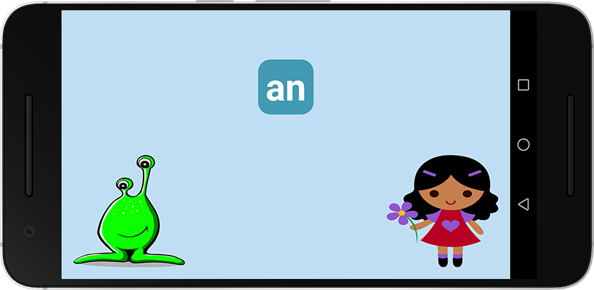
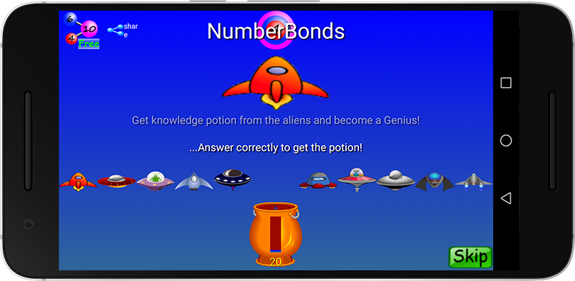
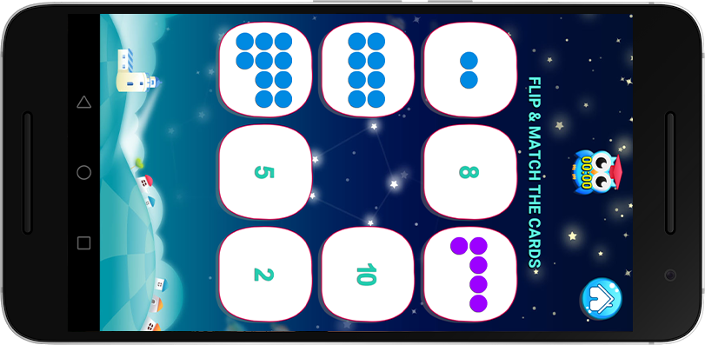
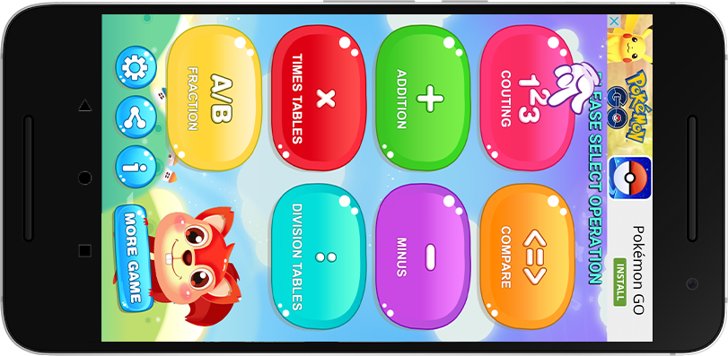
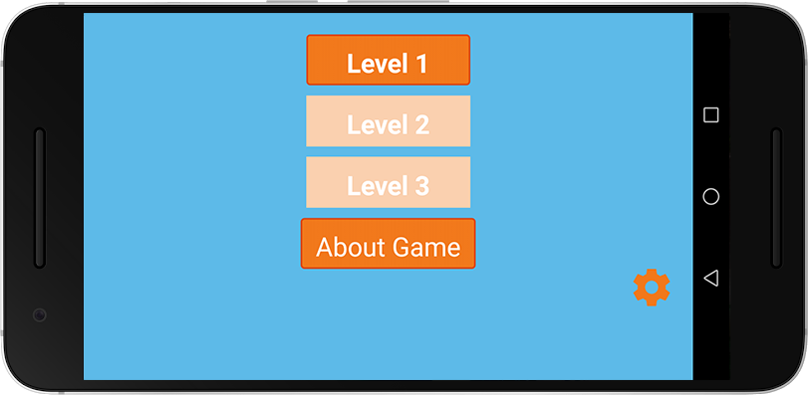
OTHER GAMES
Notes:
6
James: On the other hand, many of the games we tested were not so intuitive; they were unpolished, had unclear objectives and lacked sound effects and music.

Slide 7

OUR GAME
Notes:
7
Ben: With all that said and done, we'd now like to present to you our game, Go Ape Play. Throughout the following slides, we will talk you through the concept of our game and show you some prototype images that demonstrate the core game loop.

Slide 8
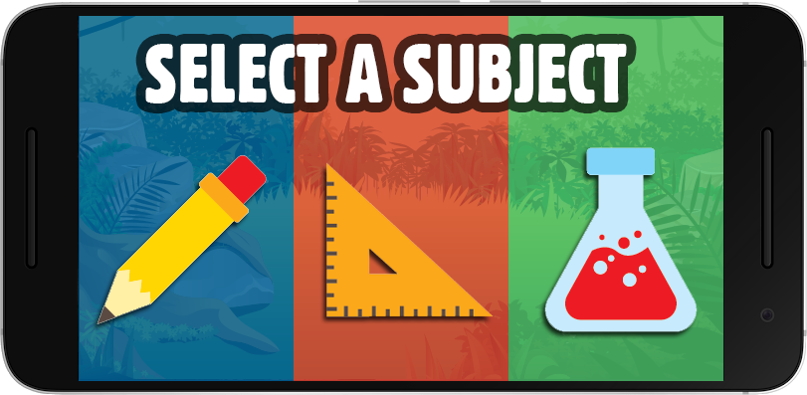
SUBJECT SELECTION
Notes:
8
James: Firstly, the player will select one of the three available subjects: English, Maths or Science.

Slide 9
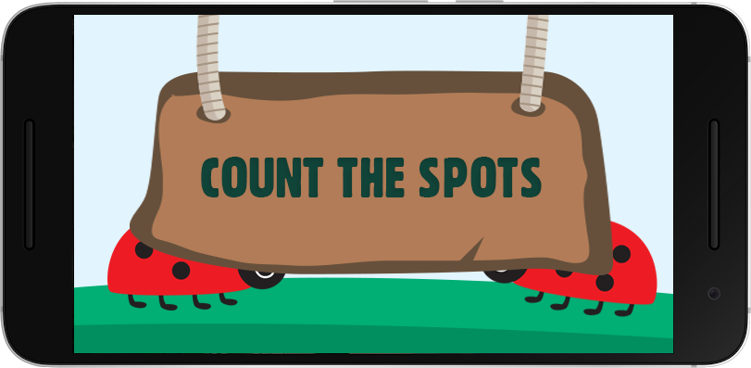
COMPLETE CHALLENGES
Notes:
9
Ben: They will then be taken through a series of challenges related to the subject that they selected, the difficulty of which will progressively increase.

Slide 10
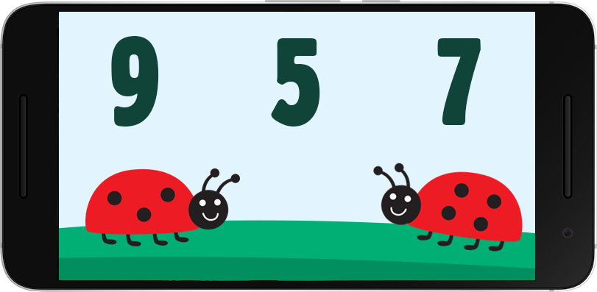
COMPLETE CHALLENGES
Notes:
10
Ben: This example details a simple addition task in which the player must calculate the total sum of the spots visible on the ladybird's backs. Additional challenges will entail things such as spelling short words and identifying animals.

Slide 11
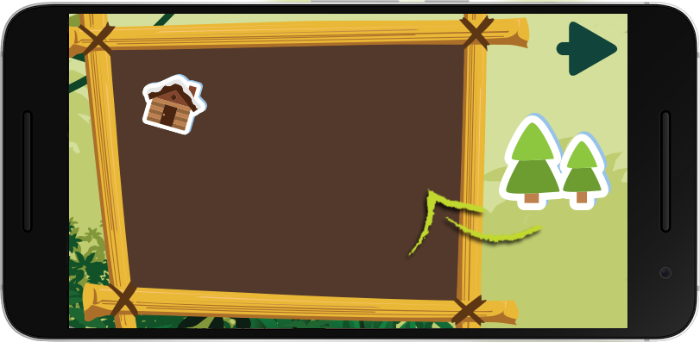
EARN STICKERS
Notes:
11
James: After completing a set of challenges, players will be awarded a sticker that they can add to their collection. This sticker collection will serve as a visual representation of their in-game achievements. Upon completion, players will be brought back to the subject selection screen and be able to progress through further and more difficult challenges. The player's ultimate goal is to fill their sticker book by completing all of the available challenges and difficulty levels.

Slide 12
SUBJECT SELECTION
Notes:
12
James: Firstly, the player will select one of the three available subjects: English, Maths or Science.

Slide 13
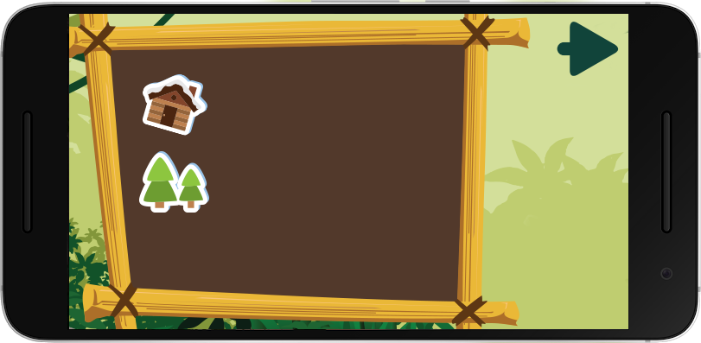
EARN STICKERS
Notes:
13
James: After completing a set of challenges, players will be awarded a sticker that they can add to their collection. This sticker collection will serve as a visual representation of their in-game achievements. Upon completion, players will be brought back to the subject selection screen and be able to progress through further and more difficult challenges. The player's ultimate goal is to fill their sticker book by completing all of the available challenges and difficulty levels.

Slide 14

HOW WILL IT BE PLAYED?
Android Mobile and Tablets
Provided to students that are visiting Go Ape on school trips.
Why Android?
Android is more cost effective than iOS.
The cost of an Android tablet could be as cheap as £35 whereas an Apple iPad costs around £135 for the cheapest model.
Notes:
14
Ben: As a part of the Go Ape school trip experience, students spend time in an outdoor classroom area. At this point, Go Ape will supply them with Android tablets that have the game pre-loaded. The primary reason we have decided to primarily for Android devices is due to their affordability.

Slide 15
Notes:
15

